Slide 1
Introduction to AIDL
Android Interface Definition Language
What is IDL ?
Facilitates the communication between unknow objects or process.
AIDL
It allows you to define the programming interface that both the client and service agree upon in order to communicate with each other using interprocess communication (IPC).
Main Approach is IPC(Inter Process Communication)

Slide 2
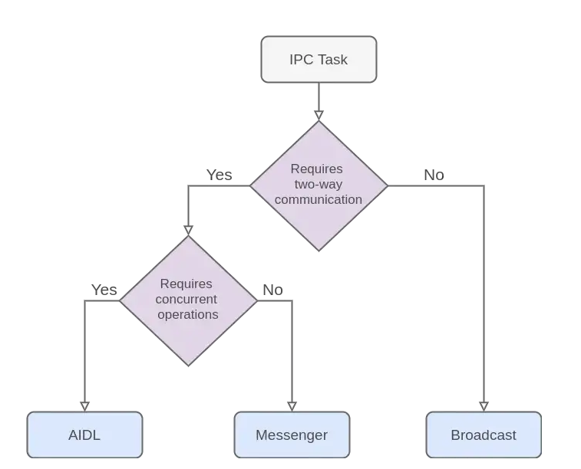
There are 3 basic methods used for IPC on android :
AIDL
Messenger(Handler)
Broadcast

Slide 3
When to use AIDL ?
Using AIDL is necessary only if you allow clients from different applications to access your service for IPC and want to handle multithreading in your service
If you do not need to perform concurrent IPC across different applications, create your interface by implementing a Binder. OR
If want to perform IPC , but do not need to handle multithreading, implement your interface using Messenger.

Slide 4
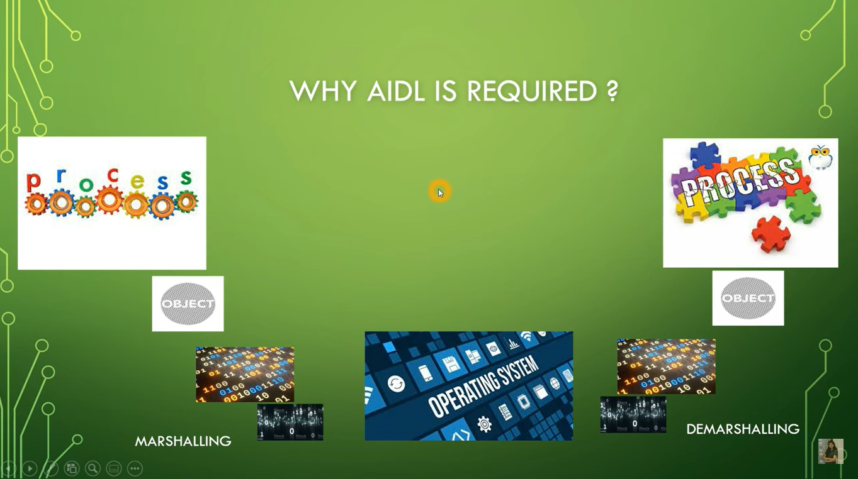

Communication between two processes
Process1
Process2
Primitive Types

Slide 5
AIDL automatically generates all the Marshaling and Demarshaling code for us.
How to create AIDL code.
Create .AIDL file (AIDL file is just an Interface that means it only contain methods,
return types, and number of parameters)
Client has to create the .AIDL file.
AIDL will create a STUB automatically.
All the communication will happen through this STUB.
Implement the interface.
Expose the interface to the client.

Slide 6
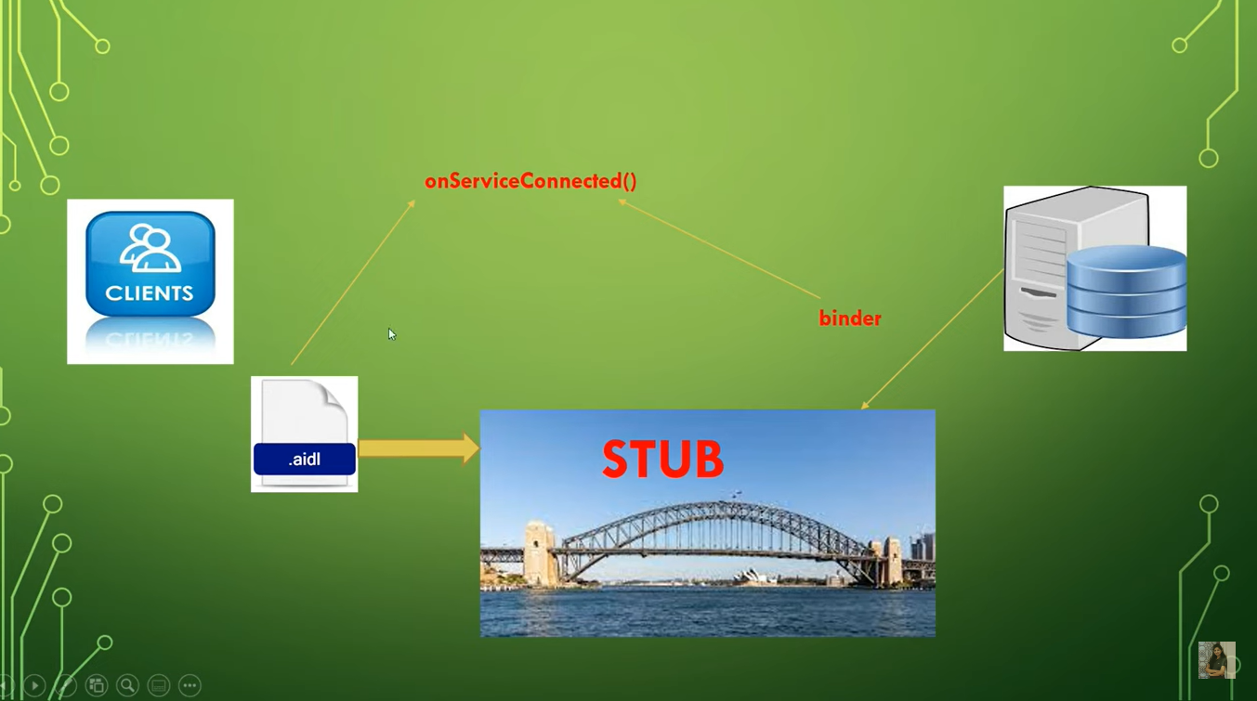
STUB will act as a bridge between client and Server.
Binder object will be passed in this method or Binder will be returned to this method.
(Binder obj will be returned that have all the information)
Clients call bindService()
Server has to implement STUB as Binder and it will
create the instance of Binder.
Client will generate AIDL file.
Android Studio will generate STUB automatically.

Slide 7


Slide 8


